Slide 1
Initial position detection method for sensorless block wave control
Corp. Eng.
W7EVS
2019/02/28

Slide 2
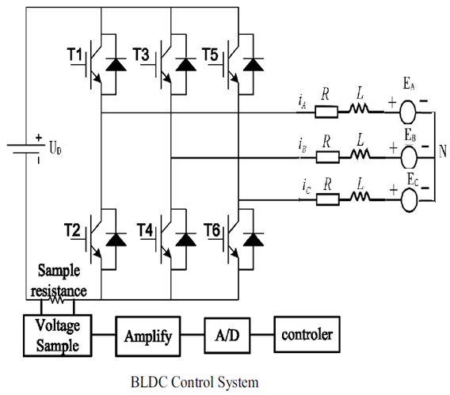
Structure diagram of BLDC system

Slide 3
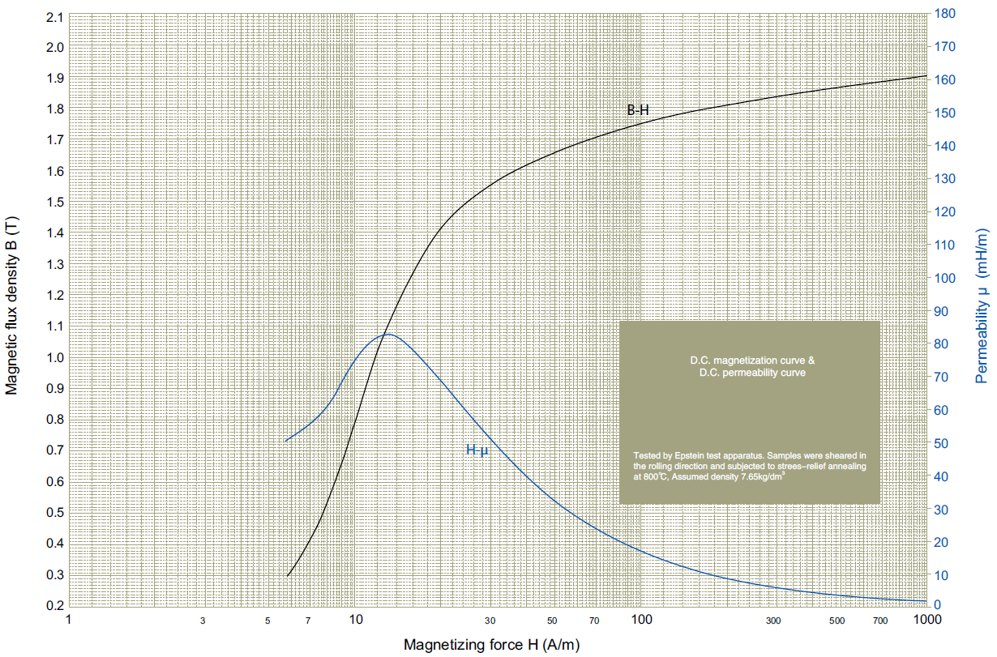
BH curve and coil inductance
BH
magnetic
Permeability
L=u*N^2*S/Len:
L: coil inductance, u: magnetic permeability; N:coil turn; S: lamination’s cross-sectional area,
Len: magnet path length,

Slide 4
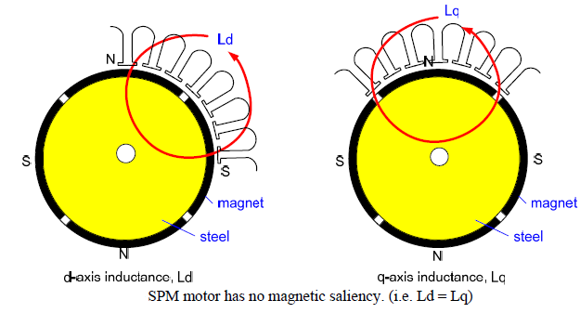
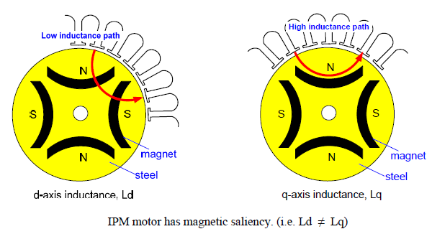
dq axis magnetic circuit for SPM and IPM
dq axis magnetic circuit
Actually for SPM motor, permanent magnet and air have slightly different magnetic permeability,
different magnetic permeability and mechanical structure of rotor can lead to Ld slightly
different to Lq, and Ld<Lq.
Inductance is very complicated parameter for PMSM, Ld=F1(flux,id,iq), Lq=F2(flux,id,iq) in complicated
nonlinear function.

Slide 5
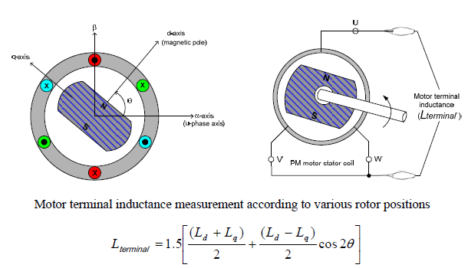
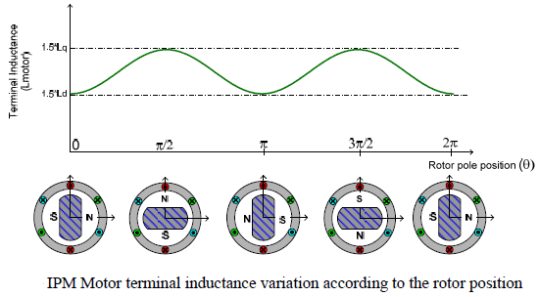
Terminal inductance formula
Coils not energized

Slide 6
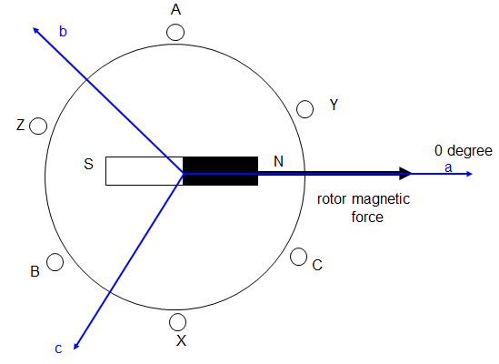
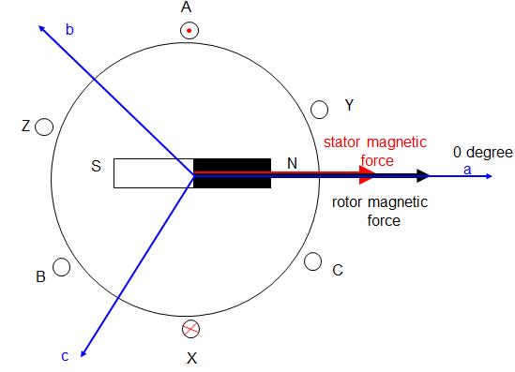
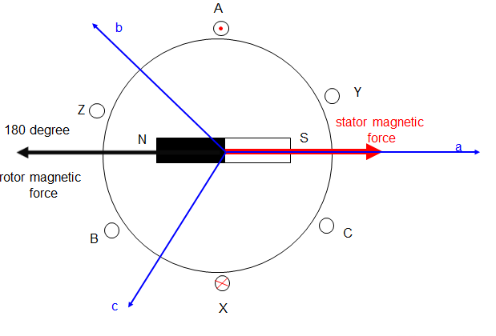
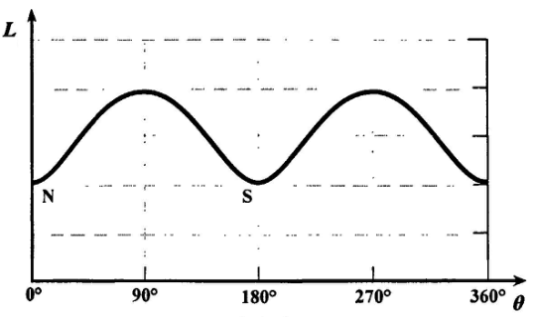
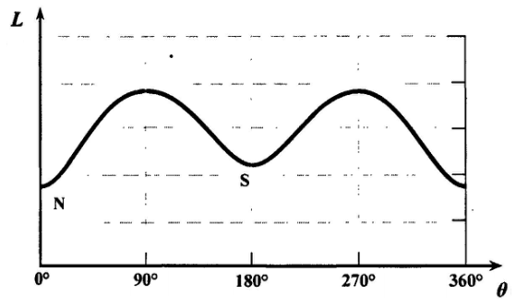
Phase inductance with magnetic effect
Coils not energized
Coils energized
Enhanced magnetic effect
Demagnetization effect
Minimal
inductance

Slide 7
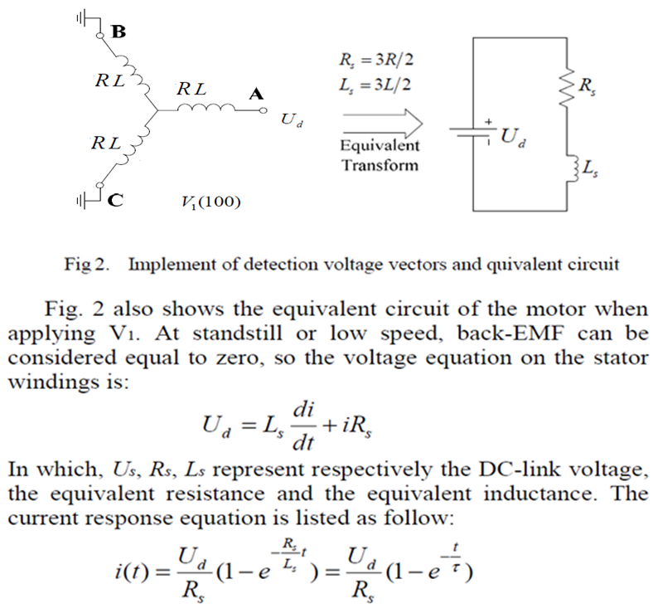
Equivalent circuit and DC-Link current response

Slide 8
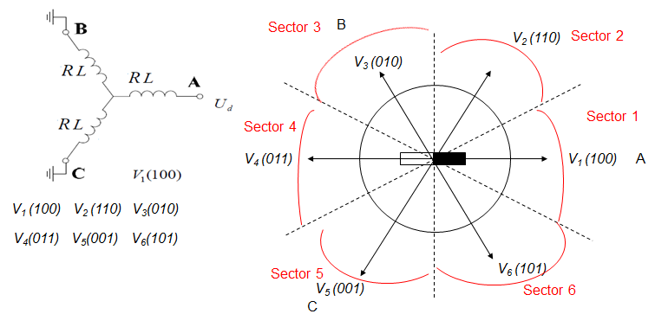
Rotor position and detecting voltage pulse
Detection voltage vectors
From Sector 1 to Sector 6, every sector spans 60 degree electrical angle, Sector 1 means rotor angle is 0 degree electrical angle; Sector 2: 60 degree electrical angle; Sector 3: 120 degree electrical angle; Sector 4: 180 degree electrical angle; Sector 5: 210 degree electrical angle; Sector 6: 270 degree electrical angle.
so when the rotor is in one sector, the max estimated electrical angle is 30 degree

Slide 9
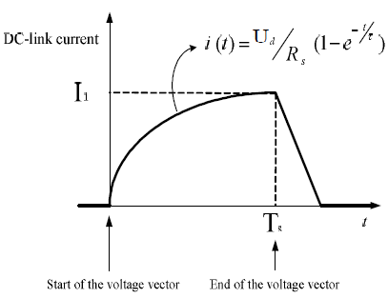
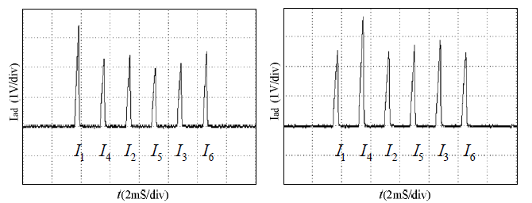
Detecting voltage pulse and DC link current response
DC-link voltage
V₁ (100)
U_{d}
t
time duration is equal to motor time constant(R/L)
V₁
V₄
V₂
V₅
V₃
V₆
V₁
V₄
V₂
V₅
V₃
V₆
With minimal
inductance
Rotor in Sector 1
Rotor in Sector 4
Rotor is located in the Sector with max DC-Link current peak value(with minimal inductance), when 6
detecting voltage pulses V1V2V3V4V5V6 are energizing. The max estimated electrical angle is 30 degree

Slide 10
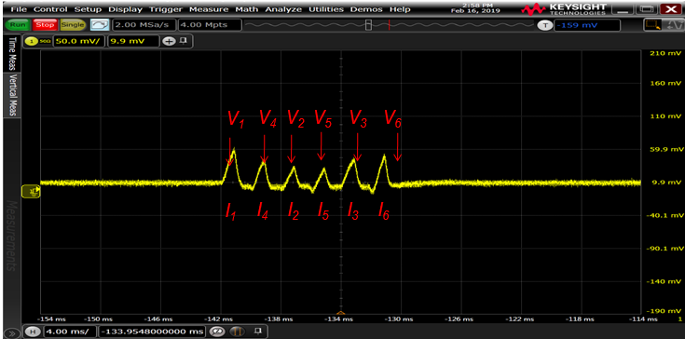
DC-link current comparison in real motor
I₁ has the max peak value, it means Sector 1 is with minimal inductance, so rotor is in Sector 1, the estimated angle is 0 degree, the max estimated electrical angle is 30 degree, the estimated angle accuracy is the same to switched hall sensor.

